Slide 1
Terraform for Azure

Slide 3
Terraform to Azure Module 05 - Terraform with GitHub Copilot and Actions
Notes:
https://developer.hashicorp.com/terraform/tutorials/modules/module

Slide 4
Overview
After completing this learning unit, you will understand
What is DevOps?
GitHub Enterprise
GitHub Copilot
GitHub Actions

Slide 5
What is DevOps?

Slide 6
What is DevOps?
People. Process. Products.
Build& Test
Deploy
DevOps is the union of people, process, and products to enable continuous delivery of value to your end users.
“
Continuous Delivery
Develop
Operate
”
Plan & Track
Monitor & Learn
Notes:
DevOps is the union of people, process and products to enable the continuous delivery of value to your end customers

Slide 7
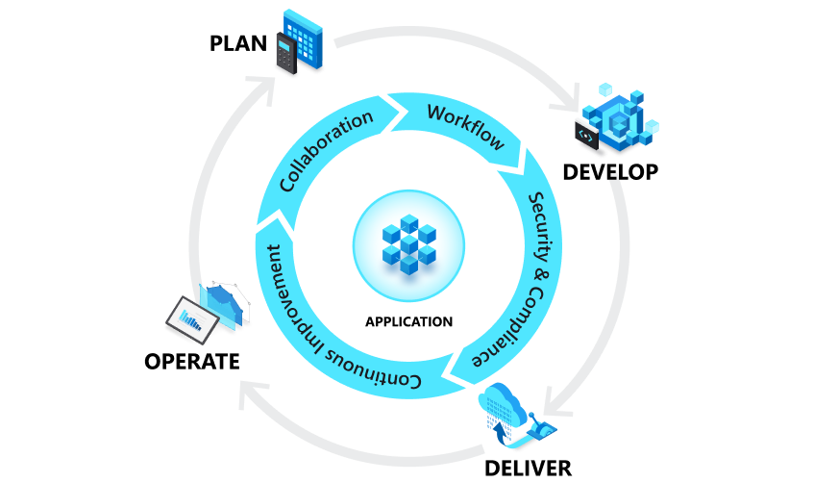
How to Achieve DevOps
Microsoft Confidential
Notes:
DevOps is the union of people, process, and products to enable continuous delivery of value to our end users.

Slide 8











single, integrated platform that empowers
developers
Introducing GitHub Enterprise
build
code
test
plan
release
monitor
deploy
operate

Slide 9
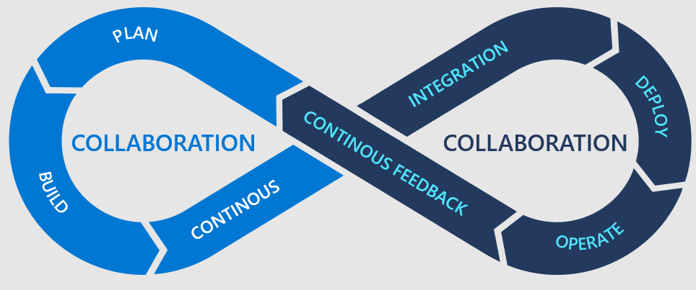
Reference Implementation with GitHub

Slide 10

Reference Implementation with GitHub
GitHub
Project V2
GitHub
Projects
GitHub
Issues
GitHub OSS
Scanning
GitHub
Mobile
GitHub Code
Scanning
GitHub
Action
GitHub
Codespaces
GitHub
Wiki
GitHub
Discussion
GitHub
Repo
GitHub Marketplace
GitHub
Insights
GitHub
Secret Scanning
GitHub
Packages
GitHub
Apps

Slide 11
GitHub Copilot

Slide 12

GitHub Copilot is an AI pair programmer. You can use GitHub Copilot to get suggestions for whole lines or entire functions right inside your editor. Focus on providing a developer experience that enables people to do their best work.
What is GitHub Copilot?
Notes:
Developer Experience is at the heart of what we do here at GitHub. When focusing on reducing the cognitive load on Developers, and making an enjoyable experience, we ensure that people can then do their best work. From an organizational perspective, this helps with attracting and retaining talent as well. This is especially important at a time where there is a shortage of developers in the market.
With such a large platform, and many developers both using GitHub for OpenSource and within their organizations, we have a lot of insights on Modern Engineering principals, and how we can enhance the developer experience to continue working at the needed velocity, while supporting our engineers.

Slide 13
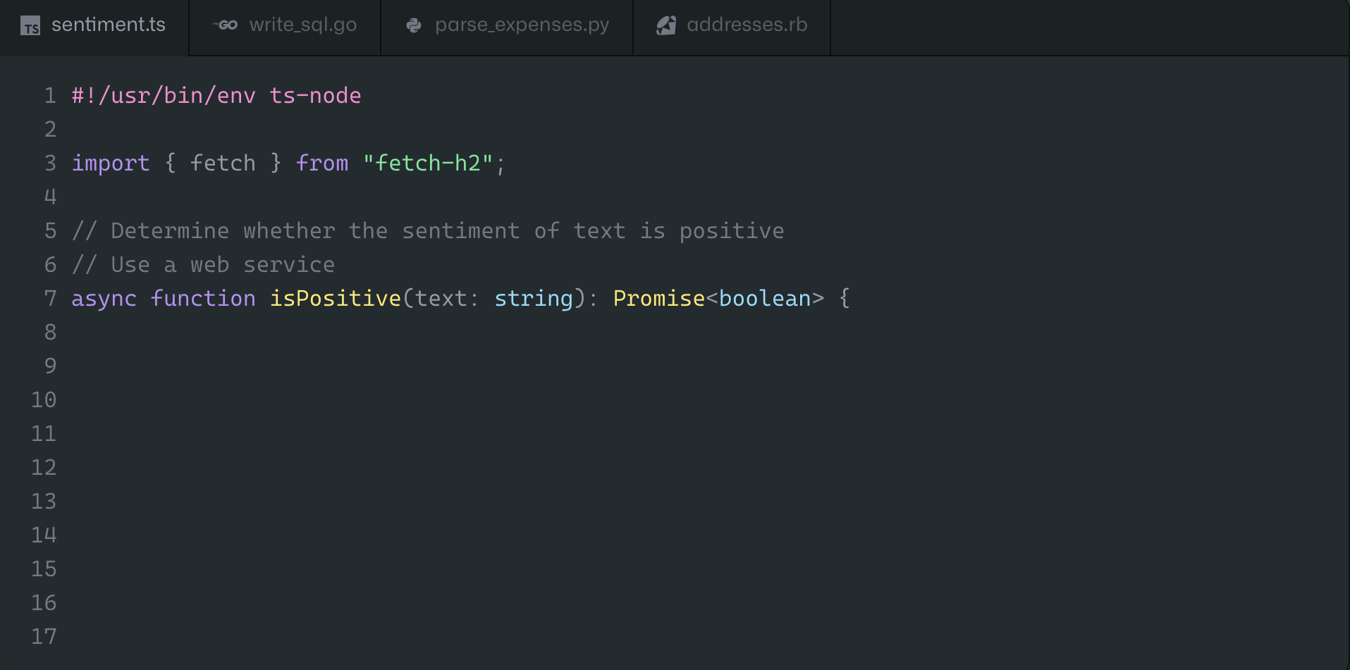

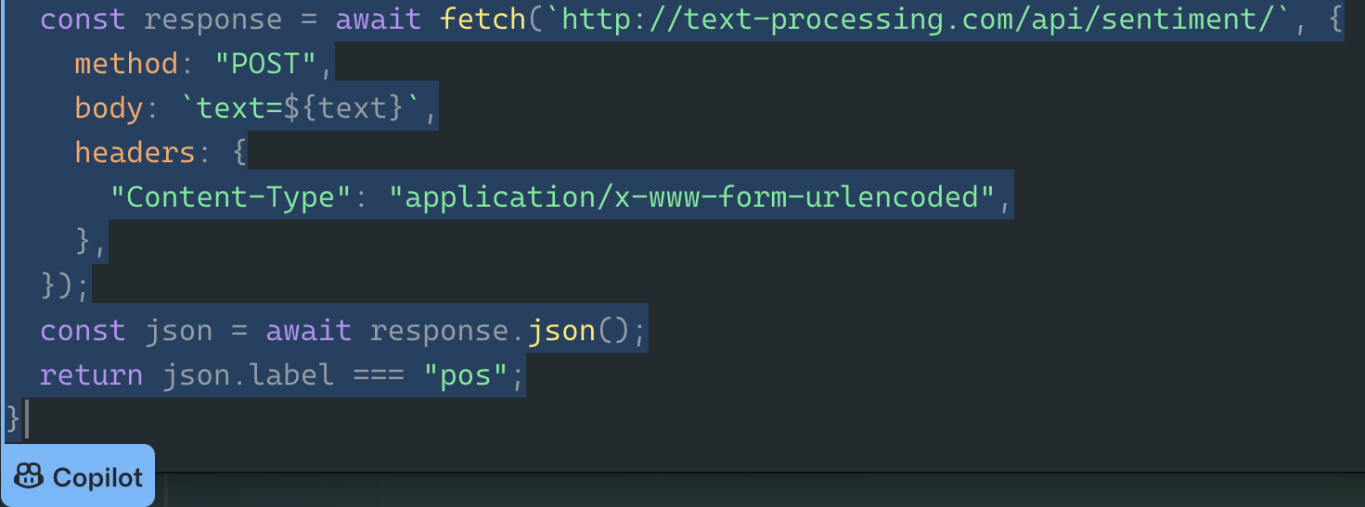
GitHub Copilot
Your AI pair programmer
Uses the context you’ve provided and synthesizes code to match
Convert comments to code
Autofill for repetitive code
Streamline test creation
Show alternatives
Notes:
Uses the context you’ve provided and synthesizes code to match
Convert comments to code: describe the logic you want, and let Copilot assemble the code for you
Autofill for repetitive code: quickly produces boilerplate and fills in repetitive code patterns
Autosuggest tests: import a unit test package and Copilot will suggest tests that match your implementation code
Show alternatives: show a list of solutions to use as provided, or edit to meet your needs
Source: https://docs.google.com/presentation/d/1sagDVAYHBt2DpAyGqMJGdkmQ05AVIrzbtyT_Onxu3bA/edit#slide=id.g1262c50b52c_0_4367

Slide 14
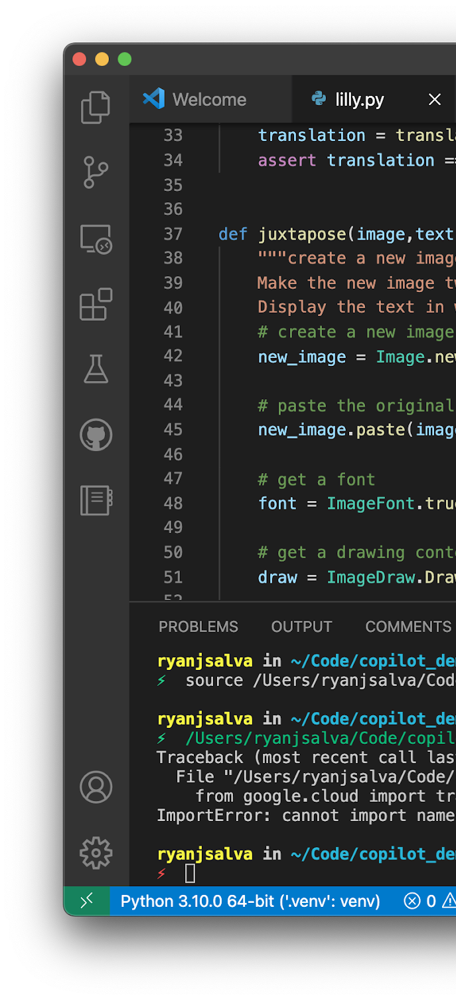



GitHub Copilot
PUBLIC DATA
OPENAI
GPT 4
CODEX
CONTEXT
SUGGESTIONS
Notes:
Here’s your code editor. It’s providing context to Copilot. Strong statement. Copilot was providing context from a local file. It wasn’t attached to a repository. That file could have been hosted on GitHub, local machine, Azure DevOps, Bit Bucket. It does not need access to your private code, or GitHub Enterprise Server, or any private instance. If you’re on premises, or have code in a locked down environment, it’s ok - GitHub Copilot works fine, as it works on context from the code editor.
If it’s taken context from the code editor - Then isn’t it sharing text / code from your code editor to the service? Yes, absolutely. However, that data is shared in an ephemeral way. It’s shared just long enough for Copilot to provide a suggestion. We do not use that code to put back into the data model for suggestions. For particularly technical audience: As a GitHub Organization administrator, you have the option of choosing a configuration option to share code back to GitHub Copilot and contribute to the model. Even then, if you decide to do that - this is based on public repositories, and not your private repositories. If you’re working on a local file, working in a private github repository, or hosted somewhere else like Azure DevOps, as far as the Copilot team are concerned, that’s off limits. They do not share that, or save the telemetry. Even if you have checked the box to share, it will only be shared in the context of a public repository.
GitHub Copilot is using the OpenAI Codex Model and GPT-3 behind the scenes. Copilot will write novel code. But having said that, Copilot is looking for language patterns, it learns language patterns. There may be some times where a particular line, or a few lines of code appear in thousands and thousands of repositories. That starts to look like a language pattern, rather than its own unique piece of code. In those cases, Copilot will occasionally regurgitate what it thinks is a pattern as it’s seen it so many times. For that case, Copilot team have introduced an IP filter, to check if anything over 150 characters against a public corpus of data. This is done on the Service side of GitHub Copilot, so is never surfaced/suggested to you as the developer, so it’s done silently in the backend. (This is another setting folks can turn on/off)> Based on that, it should be unlikely that Copilot will suggest to you already-written licensed code. (If they ask why 150 characters – Some of it is a judgement call. You don’t want it so short that you’re comparing a simple if statement, but you want to block anything that would be meaningful. But 150 characters on average is about two lines worth of code. So it’s a good length to detect if there are a couple of lines of similarity. Based on Research, the team also found that 150 characters, based on the number of suggestions presented, and accepted, was about the same as it was without the IP being thrown, i.e. the Developer Experience did not deteriorate).
GitHub Copilot is there to enhance your day to day work. Accountants don’t do calculations in their head all day. They have calculators and tools to enable them to be more productive. Think of Copilot as the evolution of tooling and Developer Experience for us as developers.

Slide 15

Extensions for popular editors
All JetBrains IDEs
IntelliJ IDEA, WebStorm, PyCharm, Rider, etc.
neovim

Slide 16



GitHub Copilot
95
We recruited
developers , and split them randomly into two groups.
We gave them a task of writing a web server in JavaScript
50
45
Used Copilot
Did not use Copilot
78%
70%
Finished
Finished
1hr 11min
2hrs 41min
Average to complete the task
Average to complete the task
Notes:
Developers who used Copilot completed work over 50% faster than those who didn't. Think about what that could mean for the entire team. Entire teams can do their existing work in half the speed.

Slide 17
Creating prompts with GitHub Copilot
Prompt Creation: The process of giving clear instructions in natural language to computer programs, such as the large language models (LLMs) that power GitHub Copilot's functionality.
Can be a question, a statement or a description
Comments on your file
Messages in Copilot Chat
Notes:
Criação de Prompts: o processo de dar instruções claras em linguagem natural para programas de computadores, como os modelos de linguagem de grande porte (LLMs) que impulsionam as funcionalidades do GitHub Copilot. O que o Copilot interpreta como um prompt? - Pode ser uma pergunta, uma afirmação ou uma descrição do que você quer que o Copilot faça
- Aceito na forma de comentários em seu arquivo ou mensagens no Copilot Chat

Slide 18
Pillars of Effective Copilot Prompts
Context
Clarity
Specificity
Intention
Information provided in the prompt that helps the Copilot to better understand the task.
The specific goal or purpose you have in mind when creating a prompt.
The quality of being unambiguous and easy to understand.
The level of detail and accuracy in a prompt.
Notes:
Pilares de prompts eficafez do copilot:
Contexto: Informação fornecida no prompt que ajuda o Copilot a entender melhor a tarefa.
Intenção: O objetivo ou propósito específico que você tem em mente ao criar um prompt.
Clareza: A qualidade de ser inequívoco e fácil de entender.
Especificidade: O nível de detalhe e precisão em um prompt.

Slide 19
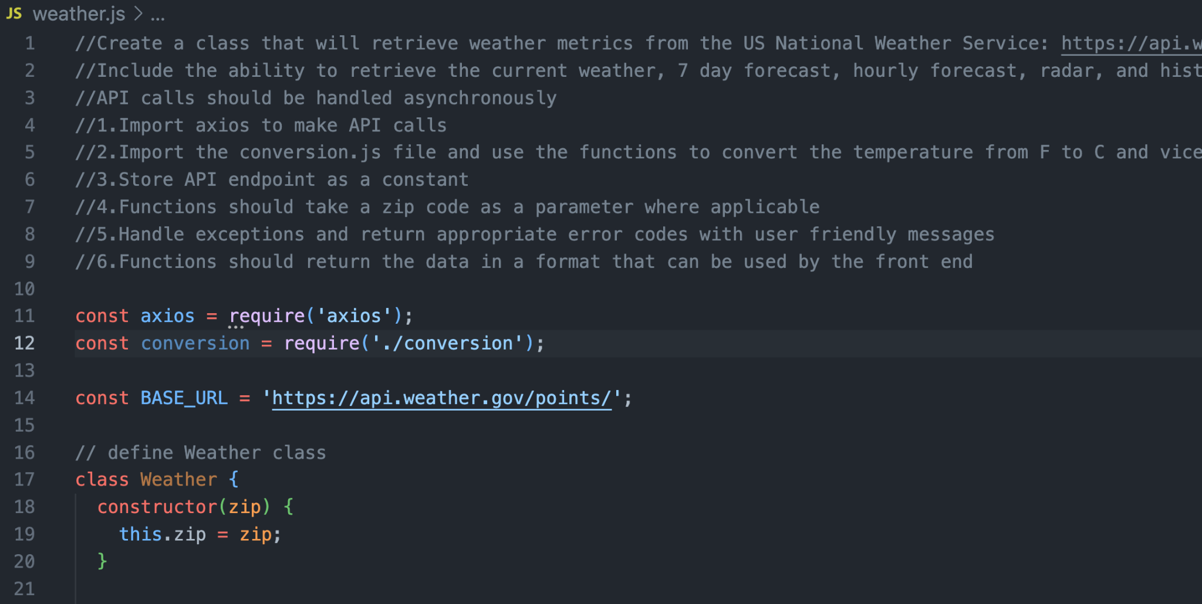
Maximize the accuracy of Copilot suggestions
Include a high-level description of your requirements at the top of your file.
Notes:
Inclua uma descrição de alto nível de seus requisitos no topo de seu arquivo. Isso é especialmente melhorado quando seguir com instruções específicas na forma de passos

Slide 20
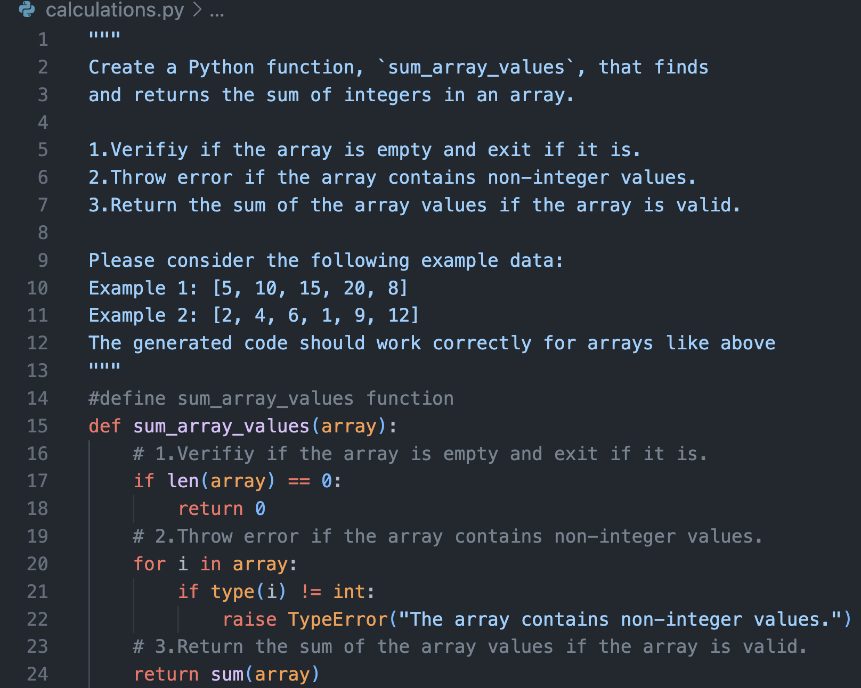
Provide examples in your prompt to clarify expectations
Notes:
Forneça exemplos em seu prompt para esclarecer expectativas

Slide 21
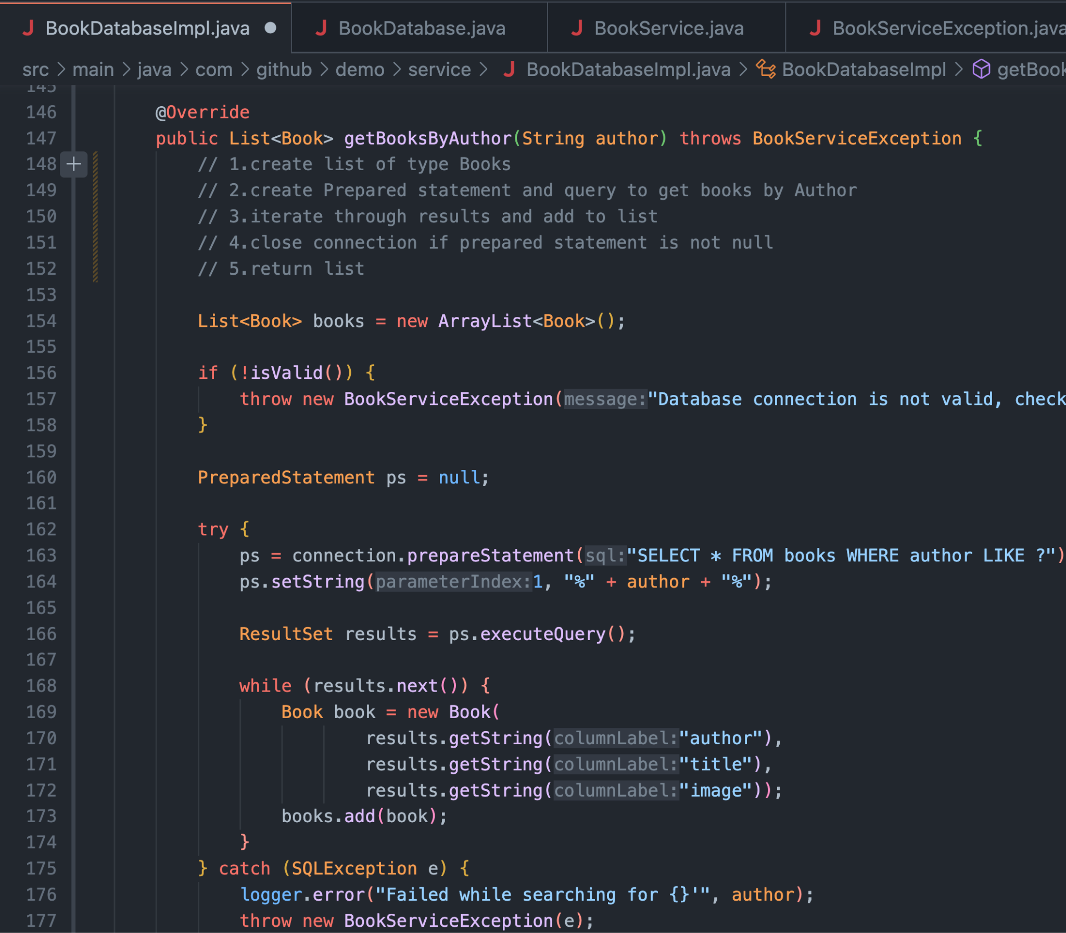
Keep files open in your project folder that are relevant to your current file requirements.
Notes:
Mantenha arquivos abertos em sua pasta de projeto que sejam relevantes para os requisitos de seu arquivo atual.

Slide 22
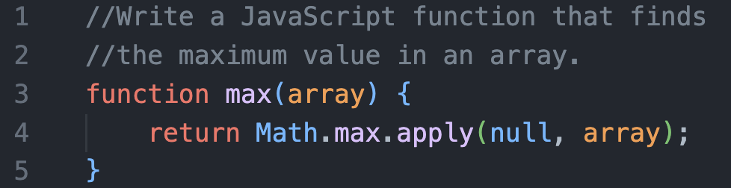
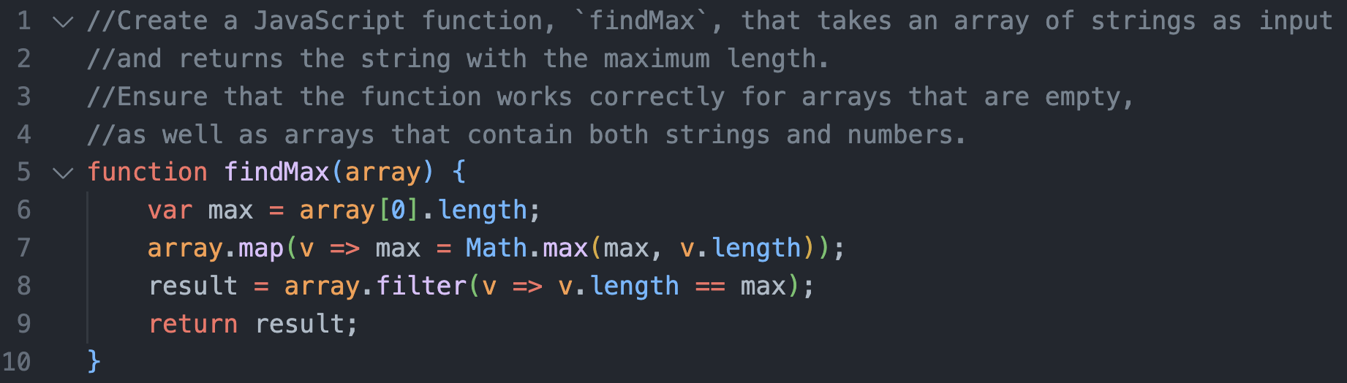
If you don't succeed the first time, try again!
First prompt
Second prompt
Notes:
Se não conseguir na primeira vez, tente outra vez passando mais detalhes sobre o que precisa

Slide 23
Enhance your experience with Copilot Chat

Slide 24
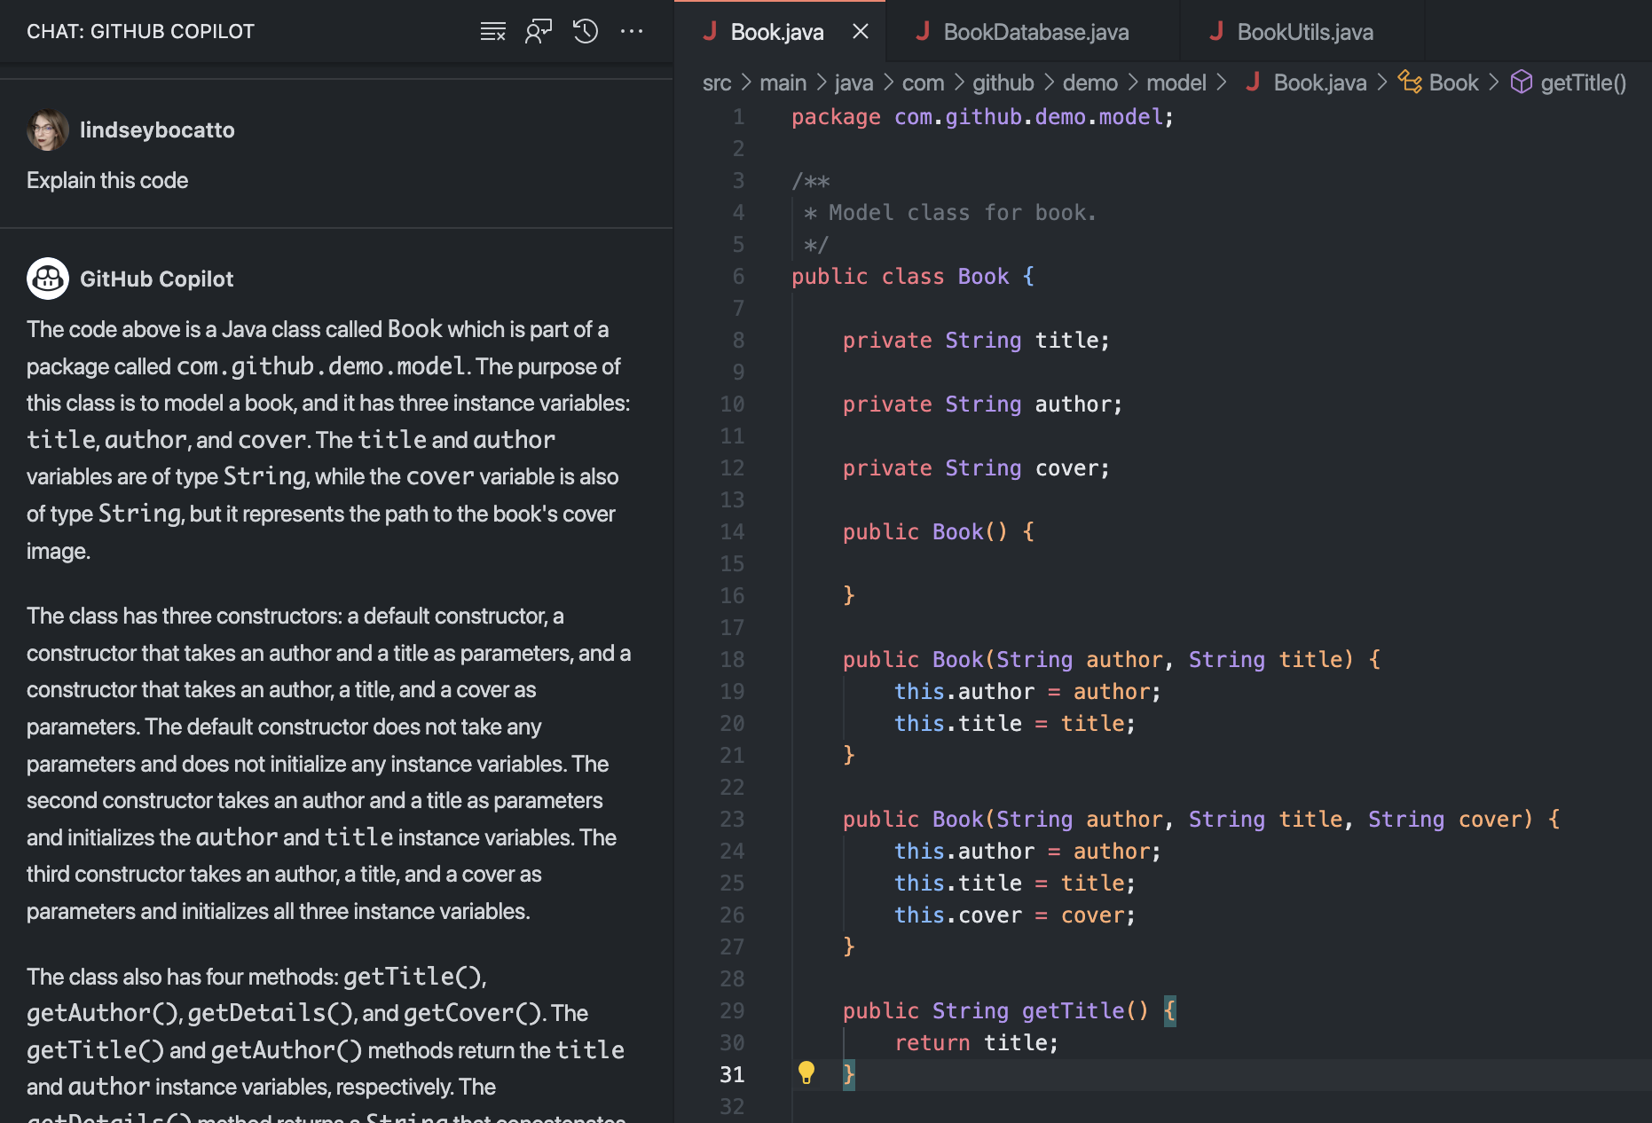
Copilot Chat: Context-aware ChatGPT style conversations
Like Copilot code-complete, Copilot Chat provides contextual suggestions for your code with an intuitive, chat-like interface.
Notes:
HOW WOULD YOU COMMUNICATE WITH A REAL PAIR PROGRAMMER?
Assim como o Copilot code-complete, o Copilot Chat fornece sugestões contextualizadas para seu código com uma interface intuitiva e semelhante a um chat.

Slide 25
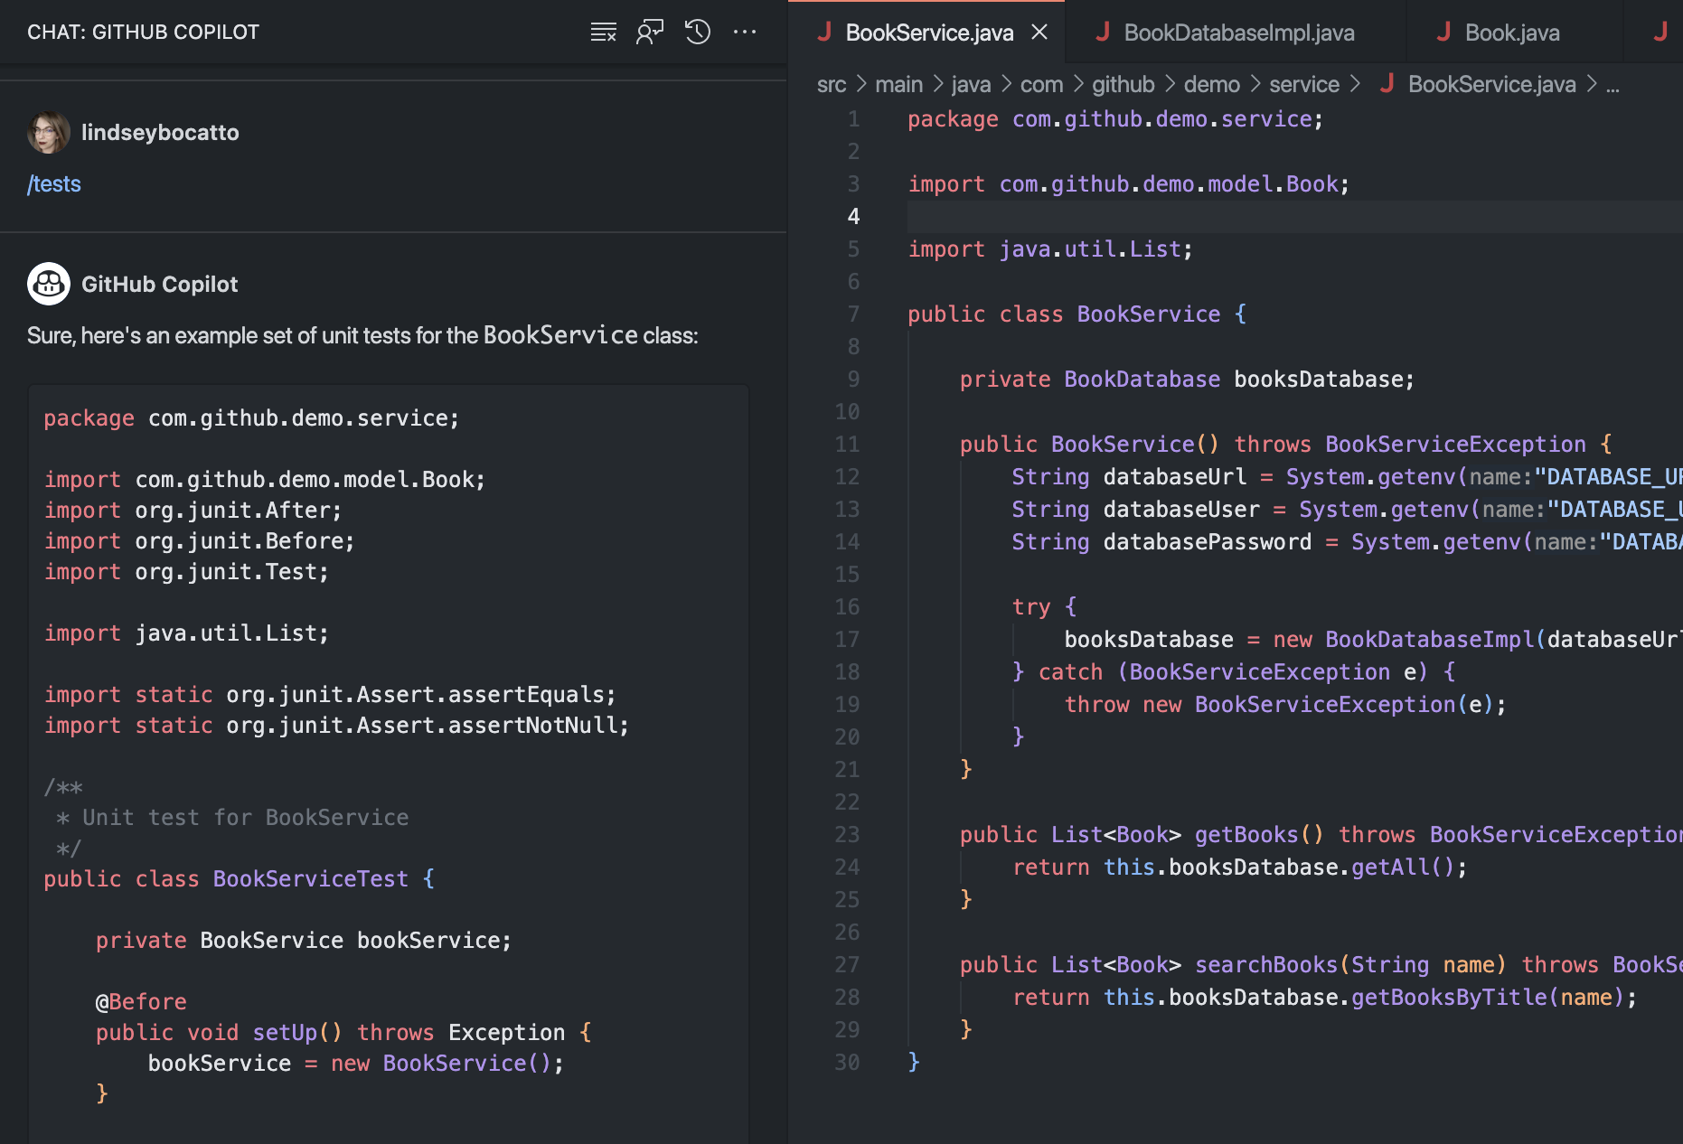
Comandos /slash
/explain
/tests
/fix
@workspace
@terminal
Explains how the selected code works
Generates unit tests for the selected code
Proposes a fix for the problems in the selected code
Ask a question about the files in your current workspace
Consult about your terminal commands
Notes:
/explain: Explica como o código selecionado funciona
/tests: Gera testes unitários para o código selecionado
/fix: Propõe uma correção para os problemas no código selecionado
@workspace: Faça uma pergunta sobre os arquivos em seu espaço de trabalho atual
@terminal: Consulte a respeito de comandos do seu terminal

Slide 26
DEMO
Notes:
Demo copilot básico:
Começando do zero
Extensões Vscode
Contexto, prompt e comandos
Copilot Chat

Slide 27
GitHub Actions

Slide 28

What is GitHub Actions
GitHub Actions is a GitHub product that allows you to automate your workflows.
Workflows stored as yml files
Fully integrated with GitHub
Respond to GitHub events
Live logs and visualized workflow execution
Community-powered workflows
GitHub-hosted or self-hosted runners
Built-in secret store
Notes:
What is GitHub Actions - Conceptually similar to other CI/CD tools
Unique differentiators
Community
Custom actions

Slide 29
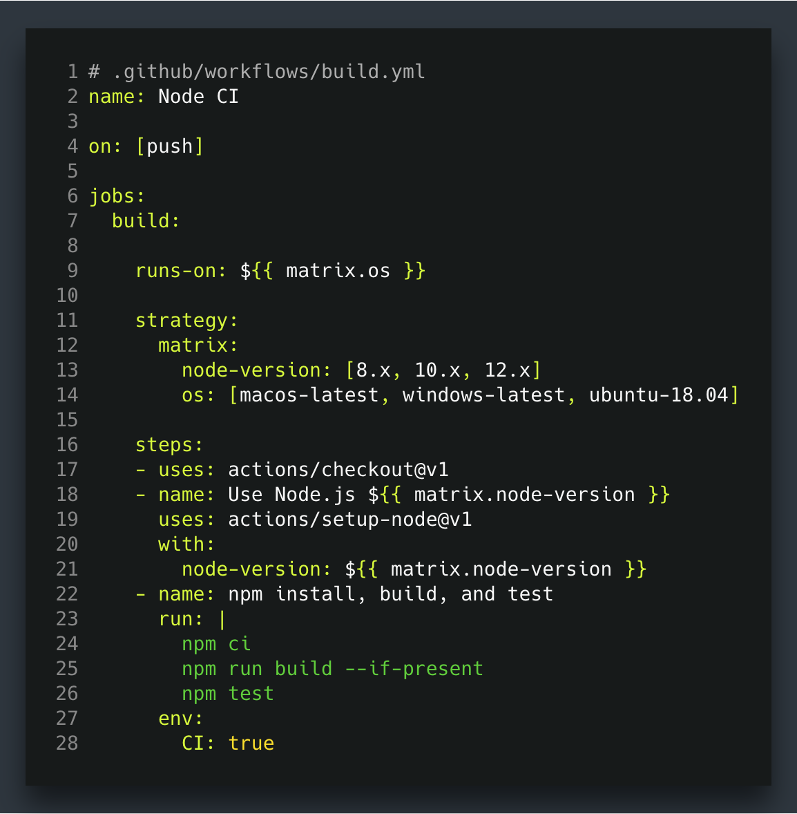
Workflows
Configurable automated processes that you can set up in your repository to build, test, package, release, or deploy any code project on GitHub.
.yaml syntax
.github/workflows
Events
Trigger
Workflows
Use
Actions

Slide 30
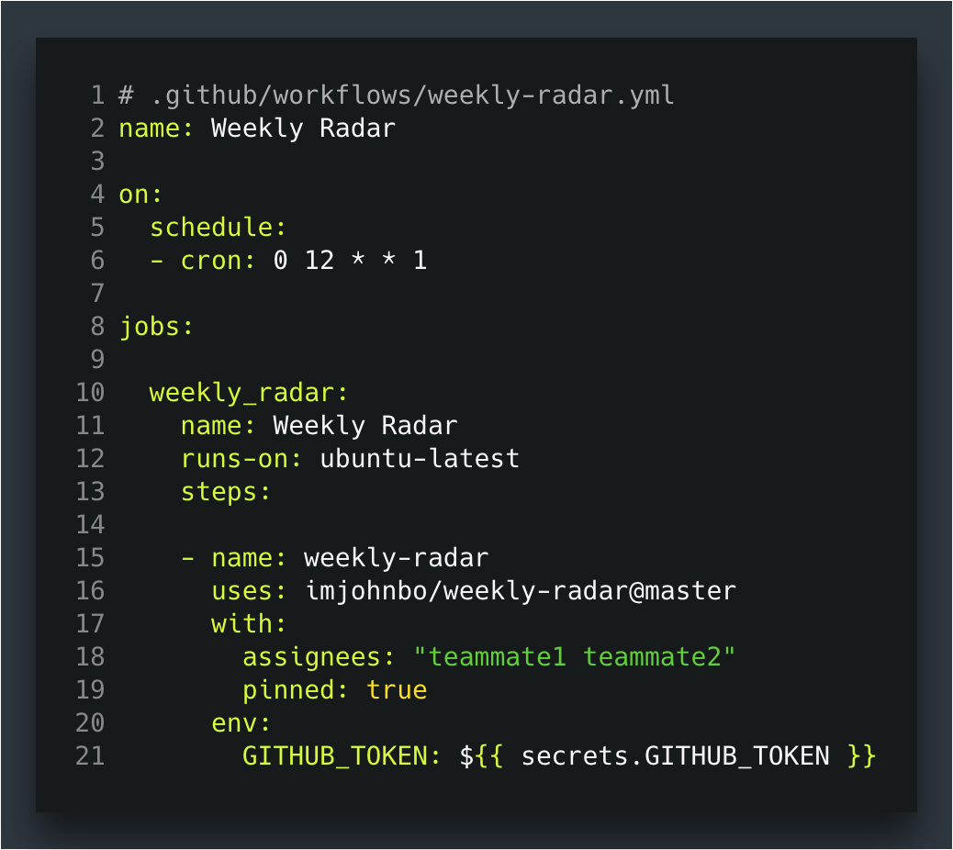
Events
GitHub workflow events are specific activities that trigger a GitHub Actions workflow.
push, pull_request, issue
Agendados: schedule
Manually triggered: workflow_dispatch

Slide 31
Jobs & Steps
Jobs: Jobs are a set of steps that execute on the same runner. By default, a workflow with multiple jobs will run those jobs in parallel. You can also configure a workflow to run jobs sequentially.
Steps: Steps are individual tasks that can run commands (like Bash, PowerShell, or Python scripts) or actions. Steps run in the order they appear in the script, and each step runs in the same runner, allowing them to share data with each other.

Slide 32
GitHub Runners
Listen for available jobs, run the jobs, and report the progress, logs, and results back to GitHub.
Runner hosted by GitHub
Self-Hosted Runner
Linux, Windows, macOS

Slide 33
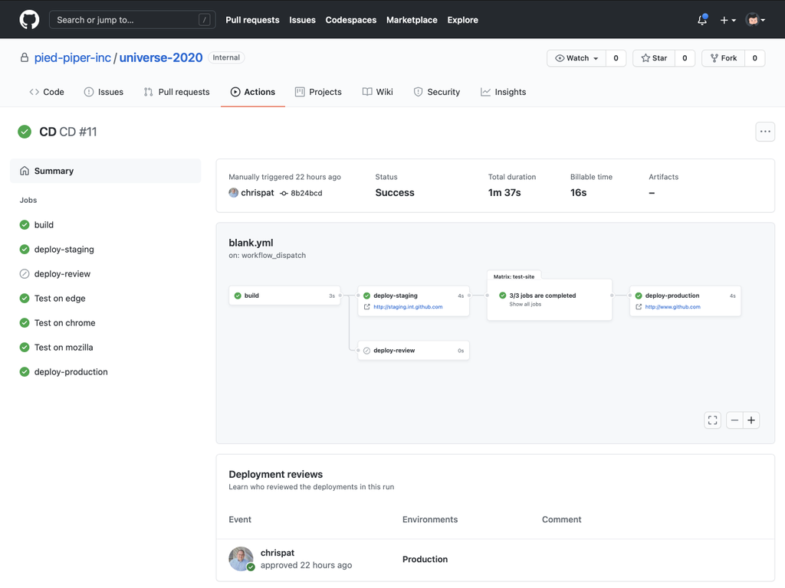
GitHub Action
Actions are individual tasks that you can combine to create jobs and customize your workflow. You can write your own actions or use and customize actions shared by the GitHub community.
Marketplace of 18,650+ Actions by our community
Any operating system, cloud and on-prem
Friction-free service or self-hosted runners
Natively integrated into GitHub workflows

Slide 34
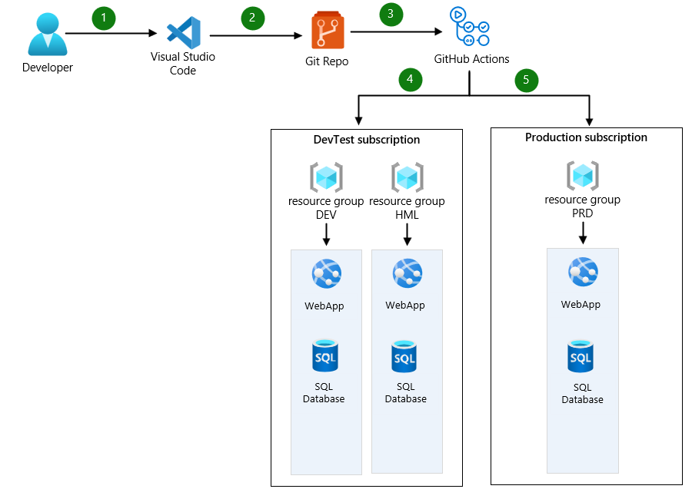
DevOps Process

Slide 35
DEMO

Slide 36
GitHub Actions Additional configurations

Slide 37
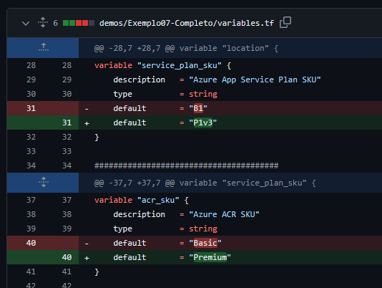
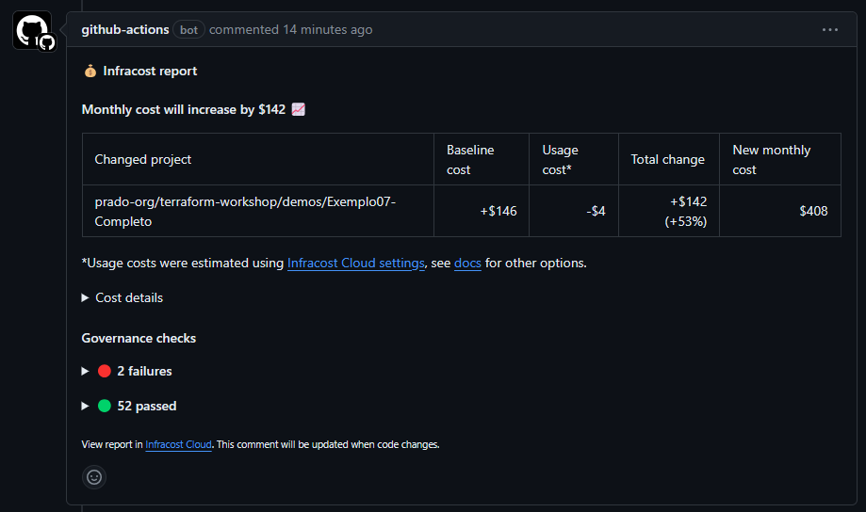
GitHub Action - InfraCost
This GitHub Action runs Infracost so you can see cloud cost estimates and FinOps best practices for Terraform in pull requests.
https://github.com/infracost/actions

Slide 38
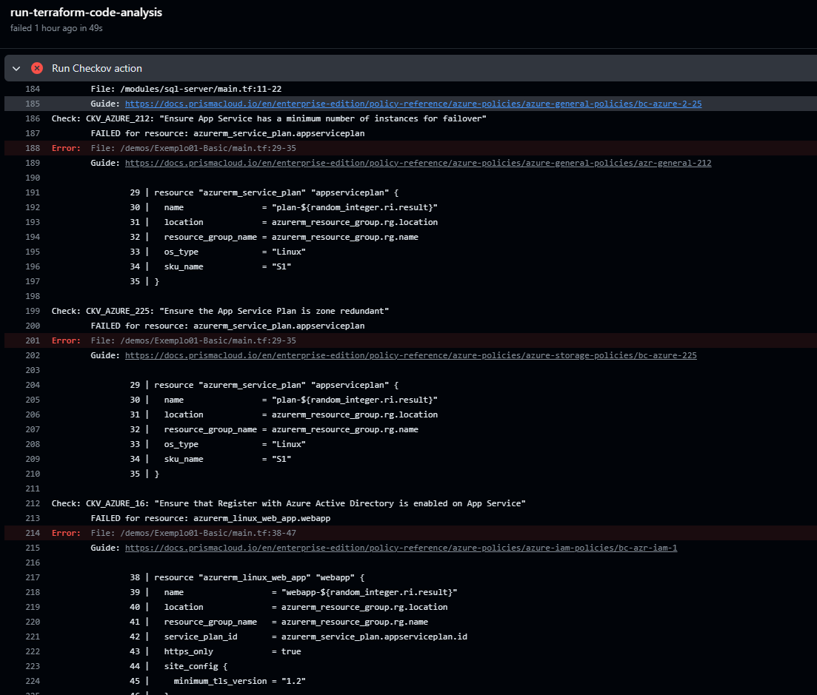
GitHub Action - Checkov
This GitHub Action runs Checkov against infrastructure-as-code, open source packages, container images, and CI/CD configurations to identify misconfigurations, vulnerabilities, and license compliance issues.
https://github.com/bridgecrewio/checkov-action

Slide 39
QUESTIONS Leandro Prado leandro.prado@microsoft.com

